Slide 1
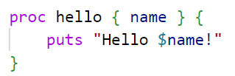

TCL
Tool Command Language
הכל בסייעתא דשמיא
By David Berger and Yehuda Shani
Lev Academic Center 5783/2023

Slide 2
What is TCL?
Created (1988) as a Powerful and flexible Scripting Language
Qualities: High-level, All-purpose, Interpreted, Dynamically Typed, Simple Syntax, Portable
Use: Scripting, Automation, Embedded into other applications (Especially EDA - Electronic Design Automation)

Slide 3
Other Language: |  | TCL
Python | Large Community | Small Community
Javascript | Supports asynchronous programming, event-driven development | Primarily single threaded
 | Ideal for frontend | Limited front end capabilities
Java | Compiled, Statically typed | Interpreter, hard to detect bugs
 | Fully supports OOP | Limited OOP, more procedural in nature
C/C++ | Manual memory management | Automatic memory management
Bash scripting | Provides many cmd-line utilities, system tools, integration with UNIX | Contains less tools, provides many elements that Bash does not provide

Slide 4
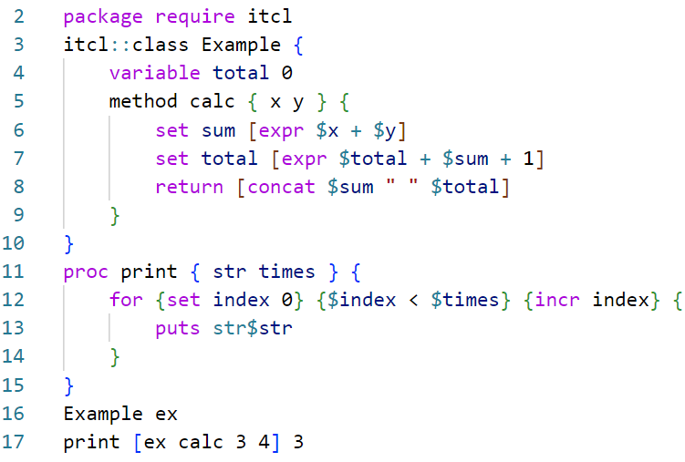
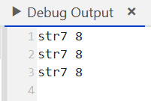
A General Example
# NOTICE:
# only one constructor
# a "proc" can exist w/out a class
# params are just sent falanga
# sensitive to " " "\n"
# line 6 - expr
# line 8 vs 13

Slide 5
Portability
Usage of Tcl grew mainly because if its embedded nature, it provided a way to build applications that were scriptable and extensible without the need to build a language for it.
Does not rely on huge libraries or OS specific functionalities (unlike Swift, Powershell, etc).

Slide 6
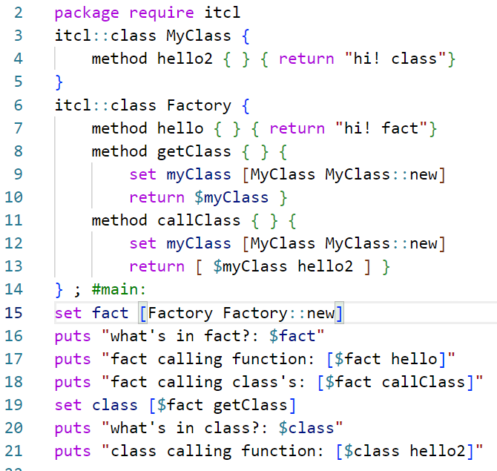
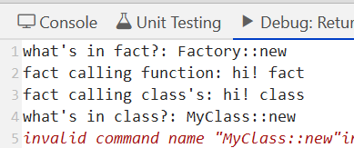
Limit to OOP: Returning Strings only..
# Notice:
# Main has an obj Factory, can access functions
# Factory can return results from it's inner class
# but factory CANT return a reference!!
to it's inner class... interpreted as a string
(also, can only have 1 ctor…)

Slide 7
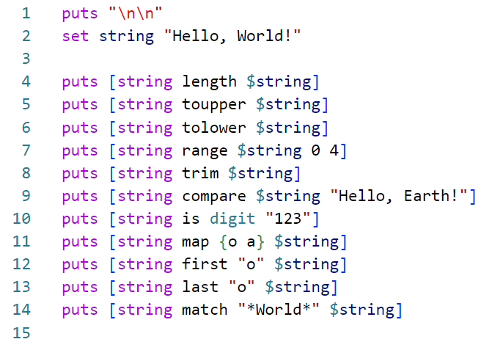
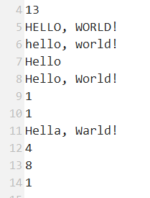
But Many Built in String Functions
# And many more..

Slide 8
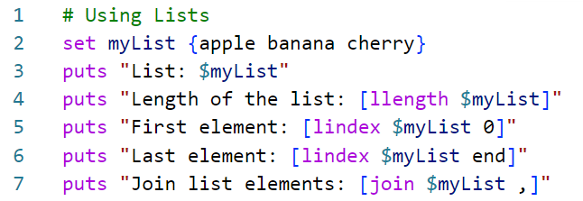
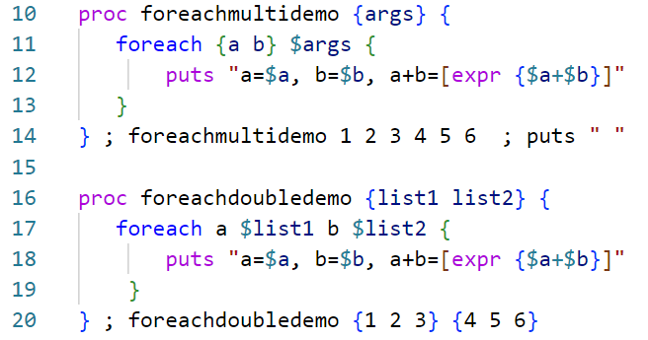
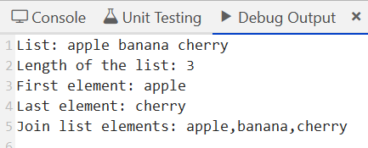
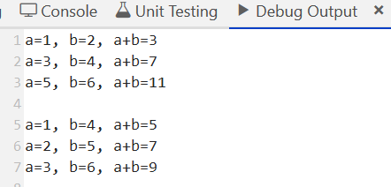
Data Structures - Lists
# notice: very intuitive commands
# but sophisticated functionality

Slide 9
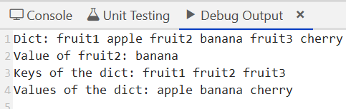
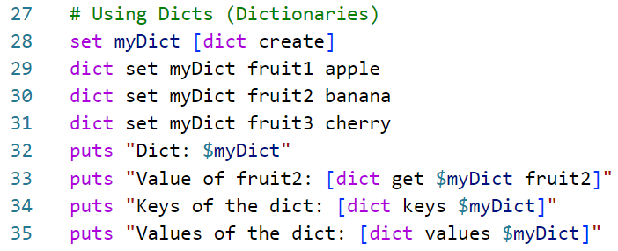
Data Structures - Dict
# There are also Arrays… but hard to do more than that

Slide 10
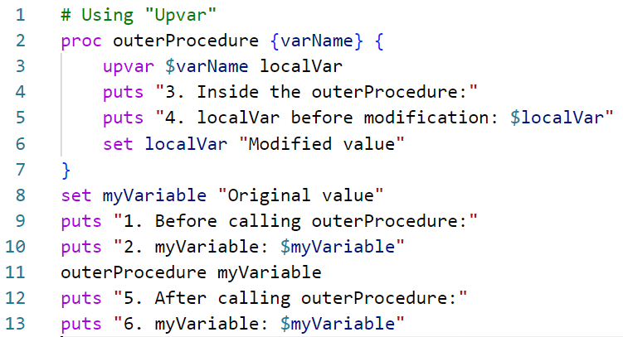
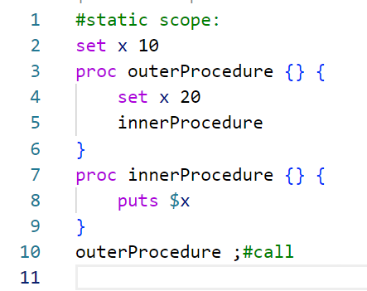
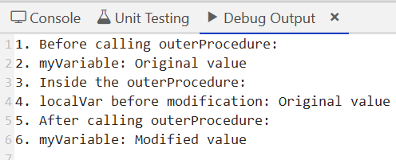

Scope: Usually Static, but…

Slide 11
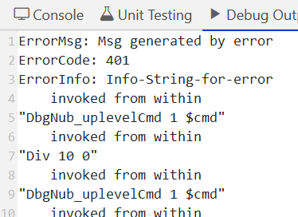
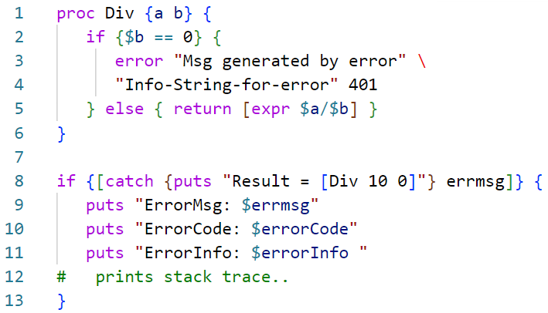
Error Messages
# But a bit cumbersome!

Slide 12
Garbage Collector
Garbage collection is used in other languages to address a problem Tcl doesn't have: The disposal of objects that are no longer reachable because all references to them have been destroyed. This problem is easier to solve in a system that produces no garbage (no passing objects by reference).
At the C level the garbage collector uses Reference Counting to dispose of objects.

Slide 13
A Few Points we didn’t touch:
# Abstraction - TCL intended for procedural abstraction and not complex data structures…
# Threads - TCL supports multithreading, but it is very uncommon (for obvious reasons)
# Very Orthogonal - (ability to build something from given pieces) : TCL provides few core commands, but they are very useful and independent
# Style - intended for Procedural, Imperative, Step-by-Step and task focused ... Limited Support for OOD. Almost never used for Parallel and Complex Multithreading.

Slide 14
Thanks for Listening, and
Thanks for a Great Course!

